Slide 1
Sensors for IoT

Slide 2
Physical Principles of Sensing
sensor is a converter of generally nonelectrical effects into electrical signals,
one and often several transformation steps are required before the electric output signal can be generated.
These steps involve changes in the types of energy or physical properties of materials, wherein the final step shall produce an electrical signal of a desirable format.
Here we will see various physical effects that can be used for a direct conversion of stimuli into electric signals

Slide 3
Electric Charges, Fields, and Potentials
We can understand by “triboelectric effect” which is a process of an electric charge separation due to object movements, friction of clothing fibers, air turbulence, atmosphere electricity, etc.
A triboelectric effect is a result of a mechanical charge redistribution.
There are two kinds of charges. Like charges repel and the unlike charges attract each other, called as positive and negative charges.

Slide 4
Electric Charges, Fields, and Potentials
Example
rubbing a glass rod with silk strips off electrons from the surface of the rod, leaving an abundance of positive charges, i.e., giving the rod a positive charge.
Electric charge is conserved—it is neither created nor destroyed.
Electric charges can be only moved from one place to another.
Giving negative charge means taking electrons from one object and placing them onto another (charging it negatively). The object, which loses some amount of electrons are said to get a positive charge

Slide 5
Electric Charges, Fields, and Potentials
With respect to electric charges, there are three kinds of materials:
Conductors,
Isolators(insulator), and
Semiconductors.
“The semiconductors are intermediate between conductors and isolators in their ability to conduct electricity. Among the elements, silicon and germanium are well-known examples”

Slide 6
Electric Charges, Fields, and Potentials
In semiconductors, the electrical conductivity may be greatly increased by adding small amounts of other elements, traces of arsenic or boron are often added to silicon for this purpose.
For sensing technologies, semiconductors are exciting materials because their ability to conduct electricity can be manipulated by applying external inputs, like electric and magnetic fields and light.

Slide 7
Electric Charges, Fields, and Potentials
Consider an object which carries a positive electric charge q.
If a small positive electric test charge q₀ is positioned in the vicinity of a charged object, It will be subjected to a repelling electric force.
If we place a negative charge on the object, it will attract the test charge.
In a vector form, the small charge will have repelling (attracting) force f.
“the test charge is subjected to force without a physical contact between charges means that the volume of space which is occupied by the test charge may be characterized by a so-called electric field”

Slide 8
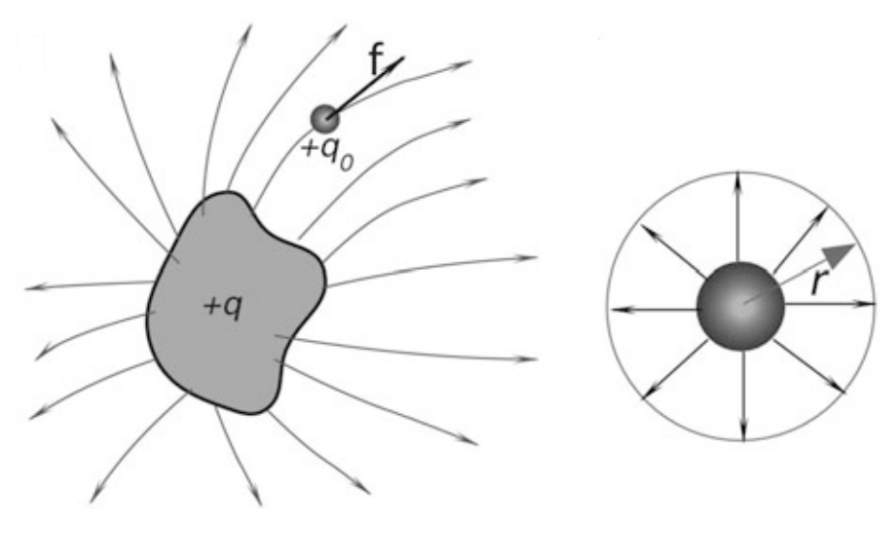
Electric Charges, Fields, and Potentials

Slide 9
Electric Charges, Fields, and Potentials
The electric field in each point is defined through the force as E= f /q0
Here E is the vector of the same direction as f because q0 is scalar.
Field is indicated by field lines, which in every point of space are tangent to the vector of force.
The field lines start on the positive object and end on the negative.
The density of field lines indicates the magnitude of electric field E in any particular volume of space.

Slide 10
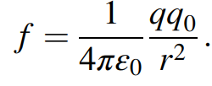
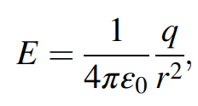
Electric Charges, Fields, and Potentials
Gauss’ law.
It states that the force acting on a test charge is inversely proportional to a squared distance from the charge
the electric field outside any spherically symmetrical distribution of charge, Fig. 4.1b, is directed radially and has magnitude

Slide 11
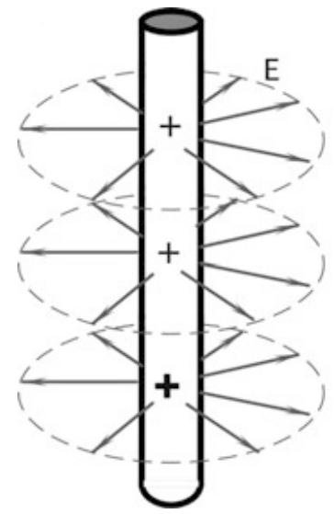
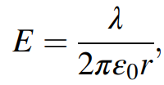
Electric Charges, Fields, and Potentials
If electric charge is distributed along an infinite line the electric field is directed perpendicularly to the line and has the magnitude
where r is the distance from the line and λ is the linear charge density (charge per unit length).

Slide 12
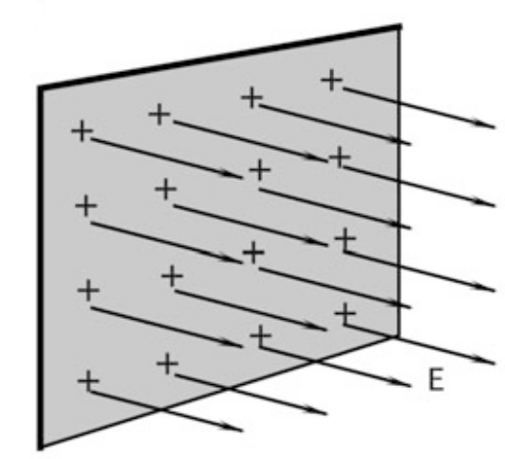
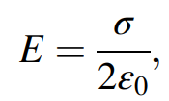
Electric Charges, Fields, and Potentials
If The electric field resulted from an infinite sheet of charge, is perpendicular to the plane of the sheet and has magnitude

Slide 13
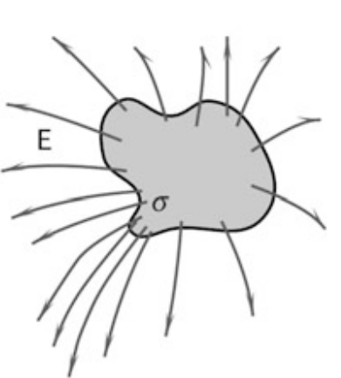
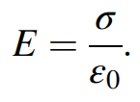
Electric Charges, Fields, and Potentials
If The electric field resulted from an infinite sheet of charge, is perpendicular to the plane of the sheet and has magnitude

Slide 14
Electric Charges, Fields, and Potentials
The change is accumulated most in the areas with the highest curvatures. This is why pointed conductors are the best concentrators of the electric field as
A very useful scientific and engineering tool that is based on this effect is a Faraday cage—a room entirely covered by either grounded conductive sheets or a metal net.
No matter how strong the external electric field, it will be essentially zero inside the cage. This makes metal airplanes, cars, and ships the best protectors during thunderstorms because they act as virtual Faraday cages

Slide 15
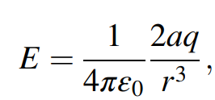
Electric Charges, Fields, and Potentials
An electric dipole
It is a combination of two opposite charges, which are placed at a distance 2a apart; each charge will act on a test charge with a force that defines electric fields E1 and E2 produced by the individual charges. A combined electric field of a dipole, E, is a vector sum of two fields. The magnitude of the field is:
where r is the distance from the center of the dipole.

Slide 16
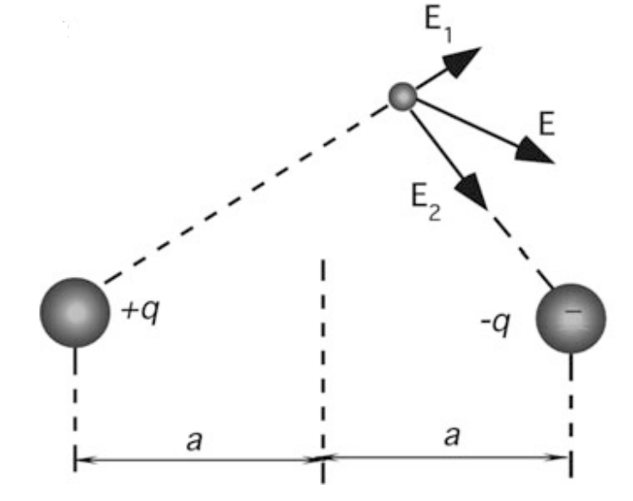
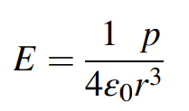
Electric Charges, Fields, and Potentials
An electric dipole
“Dipoles are found in crystalline materials and form a foundation for such sensors as piezo- and pyroelectric detectors.”
The product 2aq is called the electric dipole moment p
Hence E=

Slide 17
Electric Charges, Fields, and Potentials
Around the charged object, the field can also be described by electric potential V.
A potential is rarely used as a description of an electric field in a specific point of space, however, a potential difference (voltage) between two points is the most common quantity in electrical engineering practice.

Slide 18
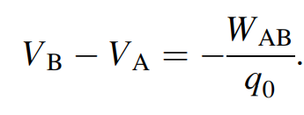
Electric Charges, Fields, and Potentials
To find the voltage between two arbitrary points, we may use the same technique as above—a small positive test charge q0.
If the electric charge is positioned in point A, it stays in equilibrium being under influence of force q0E.
It may remain there theoretically infinitely long. Now, if we try to move it to another point B, we have to work against the electric field. Work, -WAB, which is done against the field (that is why it has a negative sign) to move the charge from A to B defines voltage between these two points:

Slide 19
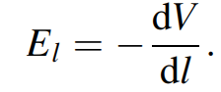
Electric Charges, Fields, and Potentials
If we travel through the electric field along a straight line and measure V as we go, the rate of change of V with distance l that we observe is the components of E in that direction
The minus sign tells us that E points in the direction of decreasing V

Slide 20
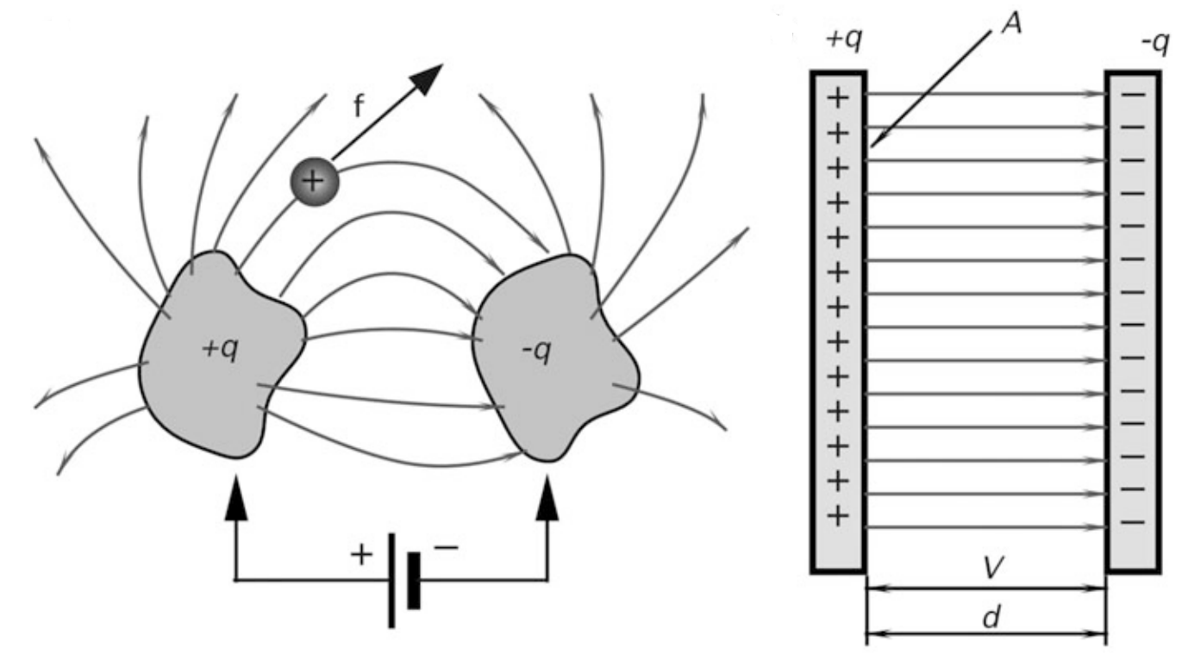
Capacitance

Slide 21
Capacitance
take two isolated conductive objects of arbitrary shape (plates) and connect them to the opposite poles of a battery. The plates will receive equal amounts of opposite charges. That is, a negatively charged plate will receive.
additional electrons while there will be a deficiency of electrons in the positively charged plate. Now, let us disconnect the battery.
If the plates are totally isolated and exist in a vacuum, they will remain charged theoretically infinitely long. A combination of plates, which can hold an electric charge, is called a capacitor.

Slide 22
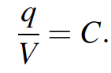
Capacitance
If a small positive electric test charge, q0, is positioned between the charged objects, it will be subjected to an electric force from the positive plate to the negative.
The positive plate will repel the positive test charge and the negative will attract it, thus resulting in a combined push-pull force. Depending on the position of the test charge between the oppositely charged objects, the force will have a specific magnitude and direction that is characterized by vector f.
The capacitor may be characterized by q, the magnitude of charge on either conductor, shown in Fig. 4.4a, and by V, the positive potential difference between the conductors. It should be noted that q is not a net charge on the capacitor, which is zero. Further, V is not the potential of either plate, but the potential difference between them. The ratio of charge to voltage is constant for each capacitor:
This fixed ratio, C, is called the capacitance of the capacitor. Its value depends on the shapes and relative position of the plates. The ratio, C, also depends on the medium in which the plates are immersed

Slide 23
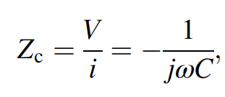
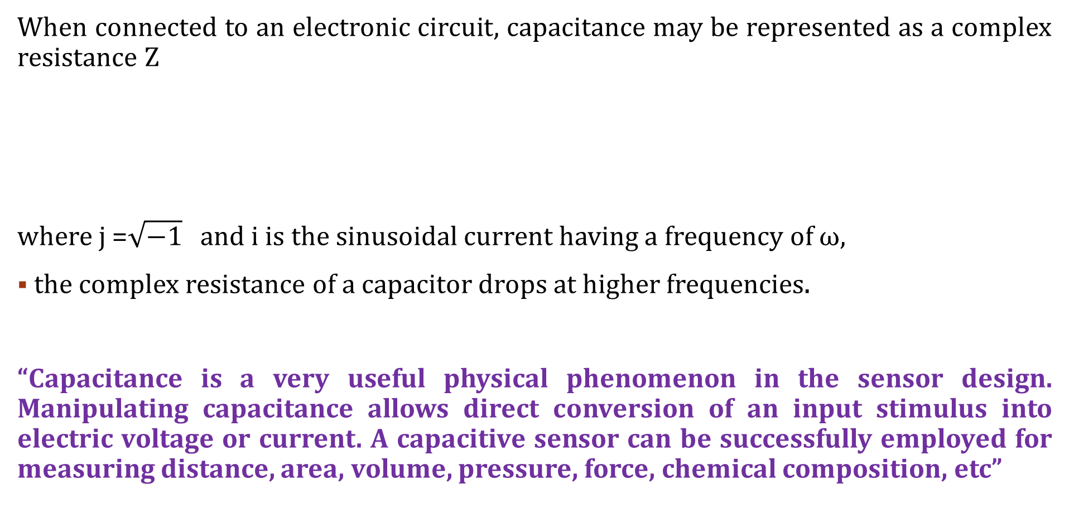
Capacitance
When connected to an electronic circuit, capacitance may be represented as a complex resistance Z
where j =$\sqrt{−1}$ and i is the sinusoidal current having a frequency of ω,
the complex resistance of a capacitor drops at higher frequencies.
“Capacitance is a very useful physical phenomenon in the sensor design. Manipulating capacitance allows direct conversion of an input stimulus into electric voltage or current. A capacitive sensor can be successfully employed for measuring distance, area, volume, pressure, force, chemical composition, etc”

Slide 24
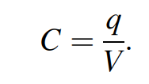
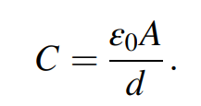
Capacitance
Capacitor
the capacitance of two parallel plates with potential difference V and charge q, is
the capacitance of a flat capacitor in vacuum :

Slide 25
Capacitance
Capacitor
Cylindrical capacitor (a); capacitive displacement sensor (b)

Slide 26
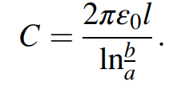
Capacitance
Capacitor
A cylindrical capacitor which consists of two coaxial cylinders of radii a and b, and length l. For the case when l >> b the capacitance is
A useful displacement sensor can be built with such a capacitor if the inner conductor can be made movable in and out of the outer conductor

Slide 27
Capacitance
Dielectric constant:
If the space between parallel plate capacitor is filled with dielectric capacitance gets increased with factor of dielectric
k is dielectric constant
Due to dielectric the molecular polarization happens
In some dielectric molecules will be polarized when external excitation is applied “called induced polarization”

Slide 28
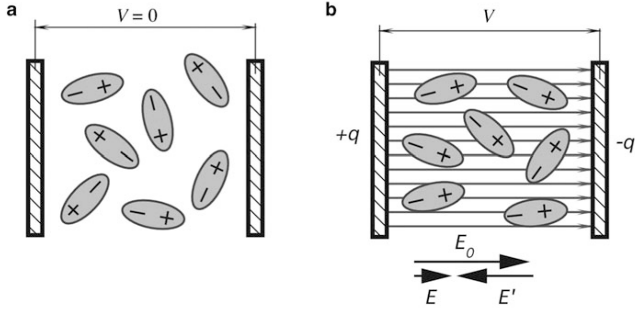
Capacitance
Dielectric constant:
Due to dielectric either permanent electric dipoles or those acquired by induction tend to align molecules with an external electric field.

Slide 29
Capacitance
Dielectric constant:
Due to dielectric either permanent electric dipoles or those acquired by induction tend to align molecules with an external electric field (Eo) called “dielectric polarization”
Each dipole forms its own electric field which is predominantly oppositely directed with the external electric field, Eo.
Due to a combined effect of a large number of dipoles (E’), the electric filed in the capacitor becomes weaker (E=Eo+E’), where the field, Eo, would be in the capacitor without the dielectric.

Slide 30
Capacitance
Dielectric constant:
Dielectric constants must be specified for a test frequency and temperature.
Some dielectrics have a very uniform dielectric constant over a broad frequency range (for instance, polyethylene),
while others display strong negative frequency dependence, that is, a dielectric constant decreases with frequency.
Temperature dependence is also negative.

Slide 31
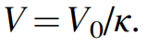
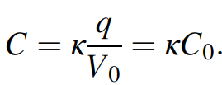
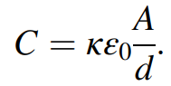
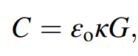
Capacitance
Dielectric constant:
Reduced electric field leads to a smaller voltage across the capacitor:
,
In a more general form, the capacitance between two objects of any shape may be expressed through a geometry factor, G
where G depends on the shape of the objects and their separation.

Slide 32
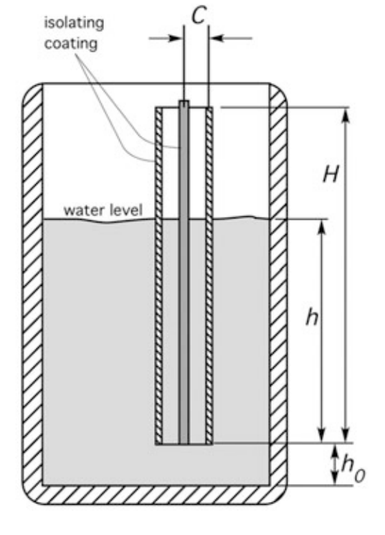
Capacitance
capacitive water level sensor

Slide 33
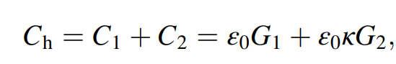
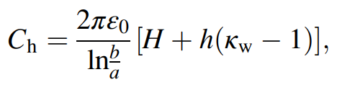
Capacitance
capacitive water level sensor
Total capacitance of the coaxial sensor is
where C1 is capacitance of the water-free portion of the sensor and C2 is capacitance of the water-filled portion. The corresponding geometry factors are designated G1 and G2.
Total

Slide 34
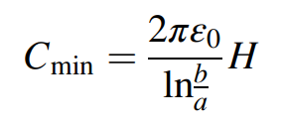
Capacitance
capacitive water level sensor
where h is the height of the water-filled portion of the sensor and κw is the water dielectric constant at a calibrating temperature.
If the water is at or below the level h0, the capacitance remains constant because h= 0 and no water is present in-between the sensor electrodes.

Slide 35
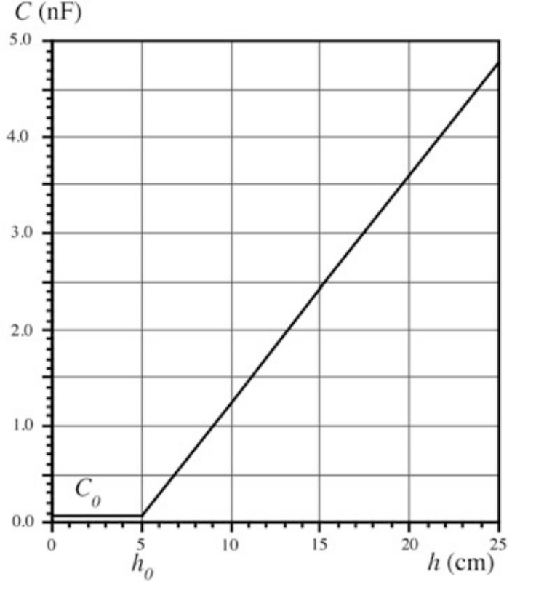
Capacitance
capacitive water level sensor
Figure below shows the water level-capacitance dependence. It is a straight line from level h0. for a =10 mm, b=12 mm, H=200 mm, liquid—water

Slide 36
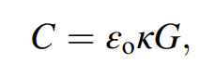
Capacitance
Another example of a capacitive sensor is a humidity sensor. In such a sensor, a dielectric filling between the capacitor plates is fabricated of a material that is hygroscopic, that is, it can absorb water molecules.
The material dielectric constant varies with the amount of absorbed moisture. According to , this changes the capacitance that can be measured and converted to the value of relative humidity.

Slide 37
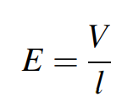
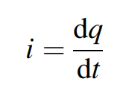
Resistance
take a bar of an arbitrary material. The length of the bar is l. When the ends of the bar are connected to the battery having voltage V , electric field E will be setup within the material. It is easy to determine strength of the electric field
The field acts on free electrons and sets them in motion against the direction of the field. Thus, the electric current starts flowing through the material.. The rate of the electric charge flowing (unit of charge per unit of time) is called electric current.

Slide 38
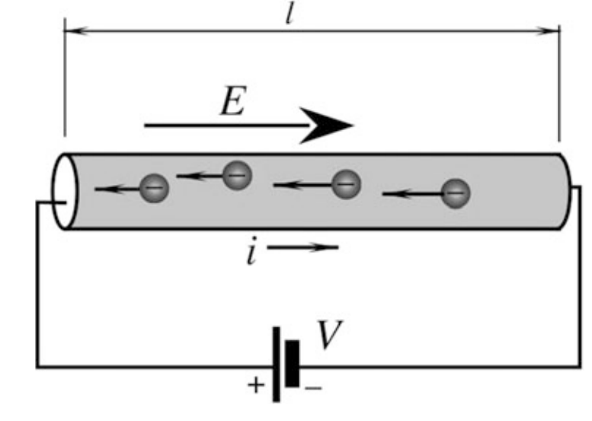
Resistance

Slide 39
Resistance
The property of the material which defines its ability to pass electric current is called resistivity, and material is said to have electrical resistance that is defined by Ohm’s law,
R= V/I
Any material has electric resistivity7 and therefore is called a resistor.
Resistance is a characteristic of a device. It depends on both: the material type and geometry of the resistor. The material itself can be characterized by a specific resistivity, ρ.

Slide 40
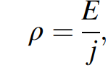
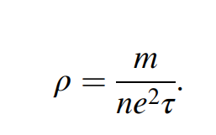
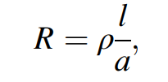
Resistance
Specific Resistance
current density j = i/a (a is the area of the material cross-section).

Slide 41
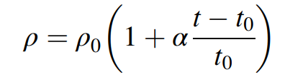
Resistance
Temperature Sensitivity of a Resistor:
Resistivity changes somewhat with temperature, t,
α is thermal sensitivity (slope), also called as the temperature coefficient of resistivity (TCR)
where ρ0 is the specific resistivity at reference temperature t0 (commonly t0 ¼ 0 or 25 C).

Slide 42
Resistance
Temperature Sensitivity of a Resistor:
When a conventional resistor is used in an electronic circuit, its resistance shall be as temperature independent as possible.
In sensing technologies, it is often desirable to have a “bad” resistor whose temperature coefficient of resistivity α is high and predictable.
A strong α allows the fabrication of two types of temperature sensors: a
“thermistor (a contraction of the words thermal and resistor), and a resistance temperature detector (RTD)”

Slide 43
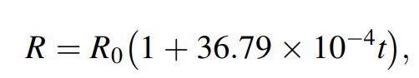
Resistance
Temperature Sensitivity of a Resistor:
The most popular RTD is a platinum (Pt) sensor
operates over a broad temperature range up to 600ºC. Resistance of a Pt RTD is
where the calibrating resistance R₀ is measured at 0 C, t is in ºC, and R is in Ω

Slide 44
Resistance
Temperature Sensitivity of a Resistor:
For a broader range of temperatures a more precise approximation
Is:
Example:
For the reference temperature, 0 C has resistivity Ro=100 Ω, for +150 C t, what will be the resistance for both function:

Slide 45
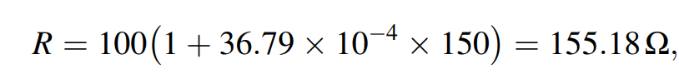
Resistance
Temperature Sensitivity of a Resistor:

Slide 46
Resistance
Temperature Sensitivity of a Resistor:
Thermistor:
It is resister with large, either negative (NTC), or positive (PTC) temperature coefficients.
For temperature measurements, usually, the NTC is employed,
PTCs thermistors, due to their very high nonlinearity are used for applications where a lesser accuracy is traded for a very high sensitivity in a selected region.

Slide 47
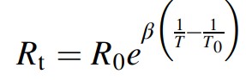
Resistance
Temperature Sensitivity of a Resistor:
Thermistor:
Thermistors possess nonlinear temperature-resistance characteristics
where T is the thermistor temperature, T0 is the calibrating temperature, R0 is its resistance at the calibrating temperature T0, and β is the thermistor material’s characteristic temperature

Slide 48
Resistance
Strain Sensitivity of a Resistor
Strain is a measure of the deformation.
Electrical resistance of a material changes when the material is mechanically deformed.
Strain is a measure of the deformation
A mechanical deformation modulates either the specific resistivity or the geometry factor.
“A good resistor better be stable, while having a bad resistor gives us an opportunity to make a sensor”

Slide 49
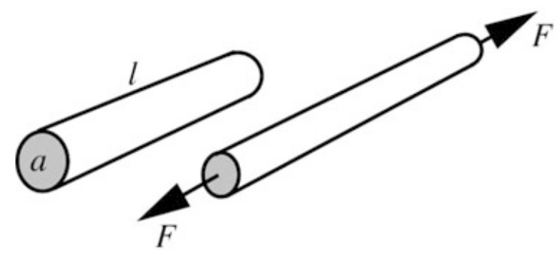
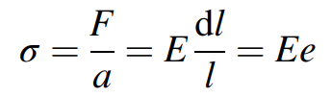
Resistance
Strain Sensitivity of a Resistor
To deform a resistor and cause strain, it should be stressed. The stress, σ, relates to force as
where E is Young’s modulus of the material, F is the applied force, and a is the cross-sectional area. In this equation, the ratio dl/l=e is strain, which is a normalized deformation of the material.

Slide 50
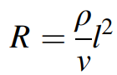
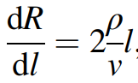
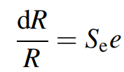
Resistance
Strain Sensitivity of a Resistor:
If a cylindrical conductor (wire) is stretched by the applied force F. Volume v of the material stays constant.
while the length increases, and the cross-sectional area becomes smaller. So
sensitivity of the wire resistor with respect to the elongation is:
The strain sensitivity of a wire becomes higher for the longer and thinner wires with a high specific resistivity
Se is known as the gauge factor or sensitivity of the strain gauge element

Slide 51
Resistance
Moisture Sensitivity of a Resistor:
ρ is also affected by the amount of moisture that can be absorbed by the resistor
A moisture-dependent resistor can be fabricated of a hygroscopic material whose specific resistivity is strongly influenced by the concentration of the absorbed water molecules.
The resistive humidity sensors are called hygristors.

Slide 52
Resistance
Moisture Sensitivity of a Resistor:
The electrodes are conductors where the space between them is covered by hygroscopic semiconductive gel that forms a matrix to suspend conductive particles.
Hygristors are active sensors; that is, they require an excitation signal to produce an electrical output.

Slide 53
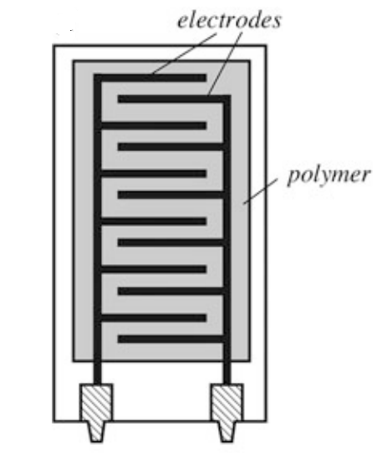
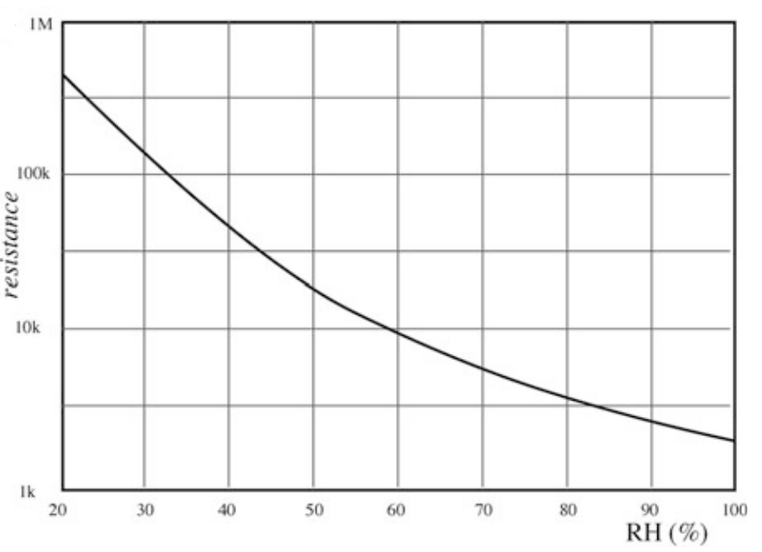
Resistance
Moisture Sensitivity of a Resistor:

Slide 54
Resistance
Piezoelectric Effect:
Piezoelectric Effect is the ability of certain materials to generate an electric charge in response to applied mechanical stress.
The effect exists in natural crystals, such as quartz (chemical formula SiO2)
It is said that piezoelectric material possesses ferroelectric properties.

Slide 55
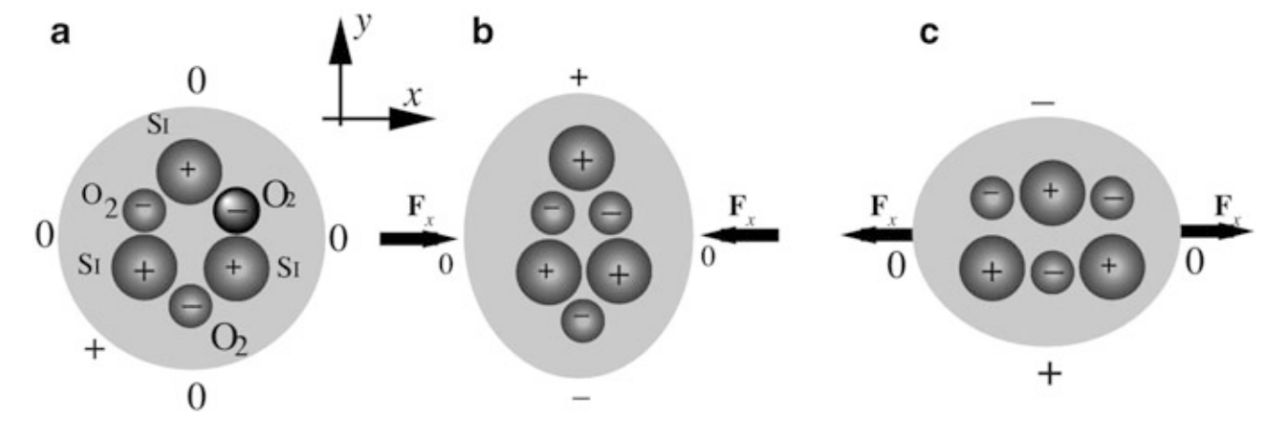
Piezoelectric Effect
Piezoelectric Effect:
Piezoelectric effect in quartz crystal

Slide 56
Piezoelectric Effect
Piezoelectric Effect:
A quartz crystal is having one silicon, Si, and two oxygen, O2,.
In a single crystal-cell, there are three atoms of silicon and six oxygen atoms.
Oxygen is being lumped in pairs. Each silicon atom carries four positive charges and a pair of oxygen atoms carries four negative charges (two per atom). Therefore a quartz cell is electrically neutral under the no-stress conditions.
When external force, Fx, is applied along the x-axis, the hexagonal lattice become deformed.
a positive charge is built up at the silicon atom side and the negative at the oxygen pair side.
Thus, the crystal develops an electric charge disbalance along the y-axis.

Slide 57
Piezoelectric Effect
Piezoelectric Effect:
If the crystal is stretched along the x-axis a charge of opposite polarity is built along the y-axis, which is the result of a different deformation. This simple model illustrates that crystalline material can develop an electric charge on its surface in response to a mechanical deformation.

Slide 58

Piezoelectric Effect
Piezoelectric Effect:
To pick up an electric charge, at least two conductive electrodes must be applied to the crystal at the opposite sides of the cut.

Slide 59
Piezoelectric Effect
Piezoelectric Effect:
a piezoelectric sensor becomes a capacitor with a dielectric material in between the metal plates, where the dielectric is a piezoelectric crystalline material. The dielectric acts as an electric charge generator, generating voltage V across the capacitor.
Although charge in a crystalline dielectric is formed at the location of an acting force, metal electrodes equalize charges along the surface, making the capacitor not selectively sensitive.

Slide 60
Piezoelectric Effect
Piezoelectric Effect:
The strain in the material charges the capacitor. A piezoelectric sensor is a direct converter of mechanical stress into electricity.
The piezoelectric effect is a reversible physical phenomenon.
This means that stress produces electricity, while voltage applied across the crystal produces mechanical strain and Material deformation. So, the piezoelectric material can convert strain to electricity and convert electricity to strain.
It is possible by placing several electrodes on the crystal to use one pair of electrodes to deliver voltage to the crystal and cause strain, and the other pair of electrodes to pick up charge resulting from developed strain.
This method is used quite extensively in various piezoelectric transducers and devices.

Slide 61
Piezoelectric Effect
Piezoelectric Effect:
The strain in the material charges the capacitor. A piezoelectric sensor is a direct converter of mechanical stress into electricity.
The piezoelectric effect is a reversible physical phenomenon.
This means that stress produces electricity, while voltage applied across the crystal produces mechanical strain and Material deformation. So, the piezoelectric material can convert strain to electricity and convert electricity to strain.
It is possible by placing several electrodes on the crystal to use one pair of electrodes to deliver voltage to the crystal and cause strain, and the other pair of electrodes to pick up charge resulting from developed strain.
This method is used quite extensively in various piezoelectric transducers and devices.
“example in the crystal oscillators”

Slide 62
Piezoelectric Effect
Piezoelectric Effect:
The strain in the material charges the capacitor. A piezoelectric sensor is a direct converter of mechanical stress into electricity.
The piezoelectric effect is a reversible physical phenomenon.
This means that stress produces electricity, while voltage applied across the crystal produces mechanical strain and Material deformation. So, the piezoelectric material can convert strain to electricity and convert electricity to strain.
It is possible by placing several electrodes on the crystal to use one pair of electrodes to deliver voltage to the crystal and cause strain, and the other pair of electrodes to pick up charge resulting from developed strain.
This method is used quite extensively in various piezoelectric transducers and devices.

Slide 63

Hall effect
The Hall sensors are widely used for detecting magnetic fields, position, and displacement of objects.
The effect is based on the interaction between moving electric carriers and the external magnetic field, known as Faraday’s law: the development of electromotive force as the electric charge moves in a magnetic field.
q=1.6 *10⁻¹⁹ C,
v is the speed of an electron,
and B is the magnetic field

Slide 64

Hall effect

Slide 65
Hall effect
Due to the magnetic field, the deflecting force shifts the moving electrons toward the right side of the strip, which becomes more negative than the left side.
The stronger the electric current and the stronger the magnetic field, the larger the number of shifted electrons.
The magnetic field and electric current produce the so-called transverse Hall potential difference V_{H}

Slide 66
Hall effect
The applications of the Hall Effect are in the sensor design:
The Hall sensors are used to detect the direction of the movement.
When a rectangular semiconductor slab is placed in a magnetic field, the force caused by the field deflects the charge carriers.
Such deflection helps to determine the movement of charge carriers in a particular direction.
Proximity or position measurement

Slide 67

Hall effect
Hall Effect sensors come with a built-in voltage regulator and DC Amplifiers that improve the device's output voltage and hysteresis.
Integrated Hall ICs exist, which incorporate amplification, stabilization, and temperature compensation.

Slide 68
Hall effect
The applications of the Hall Effect are in the sensor design:
Magnetic Field Sensors.
The Hall sensors are used to detect the direction of the movement.
When a rectangular semiconductor slab is placed in a magnetic field, the force caused by the field deflects the charge carriers.
Such deflection helps to determine the movement of charge carriers in a particular direction.
Proximity or position measurement

Slide 69
Hall effect
A linear Hall effect sensor is usually packaged in a four-terminal housing.
Terminals for applying the control current are called the control terminals and a resistance between them is called the control resistance Ri.
The terminals where the output voltage is observed are called the differential output terminals and a resistance between them is called the differential output resistance, Ro.

Slide 70

Hall effect

Slide 71

Hall effect Sensor

Slide 72
Hall effect Sensor
In a discrete Hall Effect sensor, a built-in interface circuit may contain a threshold device, thus making an integrated sensor a two-state device.
It generates “zero” when magnetic field strength is below the threshold and
Produces “one” when the magnetic field is strong enough to cross the threshold.

Slide 73

Hall effect Sensor Examples
Liquid level detector:

Slide 74
Hall effect Sensor Examples
Liquid level detector:
A permanent magnet is embedded inside a float having a hole in the center. The float can freely slide up and down over the pole that is positioned inside the tank containing liquid. The float position corresponds to the liquid level.
Hall sensor is mounted at the top of the pole which should be fabricated on a nonmagnetic material.
When the liquid level rises and reaches the detection level (release point), the Hall switch triggers and sends signal to the monitoring device. When the liquid level drops below the release point plus the threshold hysteresis, the output voltage changes indicating that the liquid level dropped.
The detection point depends on the key factors—the magnet strength and shape, the Hall sensor’s sensitivity, the hysteresis, and presence of ferromagnetic components in the vicinity of the Hall sensor

Slide 75
Sensors for strain, pressure and force
Force Sensor types
quantitative and
qualitative.
A quantitative sensor
measures the force and represents its value in terms of an electrical signal.
Examples of strain gauges and loadcells being used together with the appropriate interface circuits.
The qualitative sensors
are the threshold devices that are not concerned with a good fidelity of representation of the force value. Their function is merely to indicate whether a sufficiently strong force is applied. That is, the output signal indicates when the force magnitude exceeds a predetermined threshold level. An example of these
detectors is a computer keyboard.
Qualitative force sensors are frequently used for the detection of motion and position. A pressure-sensitive floor mat of a security system

Slide 76
Sensors for strain, pressure and force
The various methods of sensing force can be categorized as follows:
By balancing the unknown force against the gravitational force of a standard mass. (classical method)
By measuring the acceleration of a known mass to which the force is applied.
By balancing the force against an electromagnetically developed force.
By converting the force to a fluid pressure and measuring that pressure.
By measuring the strain produced in an elastic member by the unknown force

Slide 77
Sensors for strain, pressure and force
Strain Gauges :
When force is applied to a compressible resilient component, the component is deformed or strained.
The degree of strain (deformation) can be used to measure displacement under the influence of force. Thus, a strain gauge serves as a transducer that measures the displacement of one section of a deformable component with respect to its other part.
A strain gauge shall be either embedded directly into a resilient component (spring, beam, cantilever, conductive elastomer, etc.) or intimately adhered to one or more of its outside surfaces so the strain gauge will deform together with the component when a force acts upon it

Slide 78
Sensors for strain, pressure and force
Strain Gauges :
Strain is a deformation of a physical body under the action of the applied forces.
Several physical effects can be used for measuring strain.
Among them are the
optical ,
piezoelectric , and
capacitive ,
“The most popular are piezoresistive”

Slide 79

Sensors for strain, pressure and force
Strain Gauges :
A typical piezoresistive strain gauge is an elastic sensor whose resistance is function of the applied strain (unit deformation).
Since all materials resist to deformation, some force must be applied to cause deformation. Hence, electrical resistance can be related to the applied force.
That relationship is generally called the piezoresistive effect and is expressed through the gauge factor Se of the conductor.
dl/l= e (strain), Se=gauge factor or sensitivity
the resistance of a metallic wire can be approximated by a linear equation:
R=Ro(1 +x )=Ro(1+S_{e} e) ;
where Ro is the resistance with no stress applied

Slide 80
Sensors for strain, pressure and force
Strain Gauges :
For semiconductive materials, the relationship depends on the doping concentration.
Resistance decreases with compression and increases with tension.

Slide 81

Sensors for strain, pressure and force
Strain Gauges :
Wire strain gauge bonded to elastic backing

Slide 82
Sensors for strain, pressure and force
Points to be considered:
Strain from the object must be reliably coupled to the gauge wire,
The wire must be electrically isolated from the object.
The gauges may be arranged in many ways to measure strains in different axes.
Semiconductive strain gauges are quite sensitive to temperature variations.
Therefore, interface circuits or gauges must contain temperature-compensating networks.

Slide 83

Sensors for strain, pressure and force
Measurement of strain
Wheatstone Bridge circuit: A general circuit of the bridge is shown below.

Slide 84


Sensors for strain, pressure and force
Wheatstone Bridge circuit:
The bridge output voltage is represented by:
The bridge is considered to be in a balanced state when
Under the balanced condition, the output voltage is zero. When at least one impedance in the bridge changes, the bridge becomes imbalanced, and the output voltage goes either in a positive or negative direction, depending on the direction of the impedance change.

Slide 85

Sensors for strain, pressure and force
Wheatstone Bridge circuit:
In many practical circuits, only one impedance is used as a sensor,; for Z1 as a sensor, the bridge sensitivity becomes:

Slide 86


Sensors for strain, pressure and force
Wheatstone Bridge circuit:
Another type of arrangement where only two serial impedances are used as a voltage divider is called a half-bridge. The second divider is replaced by a fixed reference voltage V₀

Slide 87

Sensors for strain, pressure and force
Piezoelectric Force Sensors
Piezoelectric disk resonator as diametric force sensor

Slide 88

Sensors for strain, pressure and force
Piezoelectric Force Sensors
The approach is based on modulating a mechanical resonant frequency of the piezoelectric crystal by the applied force.
Certain cuts of a quartz crystal, when used as resonators in the electronic oscillators, shift the resonant frequency upon being mechanically loaded.
The equation describing the natural mechanical frequency spectrum of a piezoelectric oscillator is given by
n is the harmonic number, l is the resonance-determining dimension (e.g., the thickness of a relatively large thin plate or the length of a thin long rod),
c is the effective elastic stiffness or Youngs modulus in case of thin rod
ρ is density of the crystal material

Slide 89
Sensors for strain, pressure and force
Piezoelectric Force Sensors
Piezoelectric Cables
A piezoelectric effect can be employed for detecting motions of objects exerting gravitational force on a base (floor, ground, pavement, etc.).
To sense forces distributed over a relatively large area, the sensor has shape of a long coaxial cable that is placed on a hard base and is compressed when external force acts upon it.
The cable length may range from a few centimeters to many meters. It can be positioned straight or in any desirable pattern.
As with any piezoelectric sensor, the cable contains a crystalline material possessing the piezoelectric property and two electrodes placed at the opposite sides of the material.
One electrode is the outer cable conductive cladding, and the other electrode is the inner conductor, while the crystalline material is positioned in between along the cable length.
The cable generates an electric signal across the electrodes when subjected to variable compressions.

Slide 90

Sensors for strain, pressure and force
Piezoelectric Force Sensors
Piezoelectric Cables:
A piezoelectric cable consists of a solid insulated copper sheath having 3 mm outer diameter, piezoelectric ceramic powder, and an inner copper core,.
The powder is tightly compressed between the outer sheath and the core. Usually, the cable is welded at one end and connected to a 50 Ω extension cable at the other end.

Slide 91

Sensors for strain, pressure and force
Piezoelectric Force Sensors
Piezoelectric Cables
.
a piezoelectric material generates an electric charge when stressed.
The charge is proportional to the compressing force Fx:
where dx is the piezoelectric coefficient along compression coordinate x

Slide 92


Sensors for strain, pressure and force
Piezoelectric Force Sensors
When connected to a charge-to-voltage converter, the piezo induced charge first produces current:
That is converted to the output voltage:
“Where vF is the rate (velocity) of the force change. Therefore, the piezoelectric cable may be considered as the force-velocity sensor”

Slide 93

Sensors for strain, pressure and force
Optical Force Sensor:
An optical fiber is embedded into a holder that acts as a resilient component.
The fiber is positioned inside a narrow channel and split into two sections, A and B, with a small gap in between.
Light passes from A to B section through the gap.
When force is applied to the holder, it flexes, causing a misalignment between the fiber ends.
A degree of the misalignment is proportional to the applied force, the intensity of light traveling through the fiber is modulated by external force.
A photodetector positioned at the other end of section B converts light into electrical output.

Slide 94

Sensors for strain, pressure and force
Pressure Sensor:

Slide 95
Sensors for strain, pressure and force
Pressure Sensor:
for the measurement of gas pressure.
A U-shaped wire is immersed in mercury which shorts the wire resistance in proportion to the height of mercury in each column.
The resistors are connected into a Wheatstone bridge circuit that remains in balance as long as the differential pressure in the tube is zero.
Pressure is applied to one of the arms of the tube and disbalances the bridge, which results in the output signal.
The higher the pressure in the left tube, the higher the resistance of the corresponding arm and the lower the resistance of the opposite arm. The output voltage is proportional to a difference in resistances ΔR of the wire arms that are not shunted by mercury

Slide 96

Sensors for strain, pressure and force
Pressure Sensor:
for the measurement of gas pressure.

Slide 97
Sensors for strain, pressure and force
Pressure Sensor:
A pressure sensor is a complex sensor. More than one step of the energy conversion is required before pressure can be finally presented as an electrical signal.
The operating principle of many pressure sensors is based on the conversion of a result of the pressure exertion on a sensitive element having a defined surface area.
The element is displaced or deformed.
A pressure measurement may be reduced to a measurement of a displacement or strain, which results from the application of force.

Slide 98
Sensors for strain, pressure and force
The pressure sensor contains a deformable element whose deformation or movement is measured and converted by the displacement sensor into an electrical signal representative of the pressure value.
In pressure sensors, this deformable or sensing element is a mechanical device that undergoes structural changes under strain caused by pressure.
Examples bourdon tubes (C-shaped, twisted, and helical), corrugated and catenary diaphragms, capsules, bellows, barrel tubes, and other components whose shape changes under pressure.

Slide 99


Sensors for strain, pressure and force
Bellow, Membrane and thin plate:
Bellow Pressure sensor

Slide 100
Sensors for strain, pressure and force
, Bellow is intended for conversion of pressure into a linear displacement which can be measured by an appropriate sensor.
Thus, bellows performs the first step in the complex conversion of pressure into electrical signal.
The bellows is characterized by a relatively large surface area and, therefore, by a large displacement at low pressures.
The stiffness of seamless metallic bellows is proportional to the Young’s modulus of the material and inversely proportional to the outside diameter and to the number of convolutions of the bellows.

Slide 101

Sensors for strain, pressure and force
A popular example of pressure conversion into a linear deflection is a diaphragm in an aneroid(non liquid) barometer.
A deflecting device always forms at least one wall of a pressure chamber.
It is coupled to a strain sensor (for instance, a strain that converts deflection into electrical signals using piezoresistivity.

Slide 102

Sensors for strain, pressure and force
Thin plate (a) and membrane (b) under pressure p

Slide 103

Sensors for strain, pressure and force
Nowadays, a great majority of pressure sensors are fabricated with silicon membranes by using the MEMS technologies.
A membrane is a thin diaphragm under radial tension S, which is measured in N/m.
When pressure is applied to one side of the membrane, it shapes spherically, like a soap bubble. At low pressure, p, differences across the membrane, the center deflection z_{max}, and the stress σ_{m} are quasilinear functions of pressure.
where r is the membrane radius and g is the thickness.
Stress is generally uniform over the membrane area

Slide 104

Sensors for strain, pressure and force
For the membrane, the lowest natural frequency can be calculated from.
where ρ is the membrane material density.

Slide 105


Sensors for strain, pressure and force
If thickness of the membrane is not negligibly small (r/g ratio is 100 or less), the membrane is no longer a “membrane” and it is called a thin plate .
If the plate is compressed between some kind of clamping rings, it exhibits a noticeable hysteresis due to friction between the thin plate and the clamping rings.
better arrangement is a one-piece structure where the plate and the supporting components are fabricated of a single bulk of material.
For a plate, the maximum deflection is also linearly related to pressure.

Slide 106
Sensors for strain, pressure and force
For a plate, the maximum deflection is also linearly related to pressure.
where E is Young’s modulus (N/m2 ) and v is Poisson’s ratio.
The maximum stress at the circumference is also a linear function of pressure

Slide 107
Sensors for strain, pressure and force
Physical effect to detect the pressure into electrical one?
Two essential things are required
a deflection detector and
a resilient component having an area A over which the force F is distributed
Both these components can be fabricated of silicon

Slide 108

Sensors for strain, pressure and force
Piezoresistive Pressure Sensors
A silicon diaphragm pressure sensor consists of a thin silicon diaphragm (membrane) having area A as an elastic material and the piezoresistive gauge resistors made by diffusive impurities into the diaphragm.
“single crystal silicon having superior elastic characteristics, also virtually no hysteresis occurs, even under strong static pressure”
When stress is applied to a semiconductor resistor, having initial resistance R, the piezoresistive effect results in change in the resistance ΔR
here πl and π2 are the piezoresistive coefficients in a longitudinal and transverse direction, respectively. Stresses in longitudinal and transverse directions are designated σl and σ2.

Slide 109

Sensors for strain, pressure and force
Position of piezoresistors on a silicon diaphragm

Slide 110

Sensors for strain, pressure and force
Position of piezo resistors on a silicon diaphragm

Slide 111



Sensors for strain, pressure and force
Factor= Gauge the ratio of per unit change in resistance to per unit change in length
Gauge Factor G= (∆R/R)/strain
Strain (€)= ∆L/L
Stress= Youngs modules* strain= ==y€
∆R/R= G€= G /y=G/y
G/y= piezoelectric coefficient=π
∆R/R==π

Slide 112
Presence, Displacement, and Leve
Detectors of presence indicate the position of an object at a selected position or within a predefined system of coordinates.
Displacement is a shift of an object from one position to another for a specific distance or angle
Proximity detectors indicate when a critical distance is reached.

Slide 113
Presence, Displacement, and Leve
Potentiometric Sensors
A presence or displacement transducer may be built with a linear or rotary potentiometer or a pot for short.
The resistance linearly relates to the wire length.
by making an object to control the length of the wire, as is done in a pot, a displacement measurement can be performed.
a resistance measurement requires the passage of electric current through the pot wire; the potentiometric transducer is an active type.
it requires an excitation signal, for instance, d.c. current.

Slide 114


Presence, Displacement, and Leve
Potentiometric Sensors
Potentiometer as position sensor
Where D is the full-scale displacement, and v₀ is the excitation voltage across the pot

Slide 115

Presence, Displacement, and Leve
Potentioment as fluid level sensor

Slide 116
Presence, Displacement, and Leve
Potentioment as fluid level sensor

Slide 117

Presence, Displacement, and Leve
Potentioment as linear sensor

Slide 118

Presence, Displacement, and Leve
pressure-sensitive potentiometric position sensor

Slide 119
Presence, Displacement, and Leve
pressure-sensitive potentiometric position sensor
The sensor consists of two strips—the upper strip is made of flexible plastic sheet having a metalized surface. This is a contact or wiper strip.
The bottom strip is rigid and coated with a resistive material of a total resistance ranging from several kiloohms to Megaohms.
The upper conductive strip (wiper) and the bottom resistive strip are connected into an electric circuit.
When a pusher (e.g., a fingertip) is pressed against the upper strip at a specific distance x from the end, the contact strip flexes, touching the bottom strip and making an electric contact at the pressure point. That is, the contact strip works as a wiper in a pot.
The contact between two strips changes the output voltage from E to ER_{x}/R₀, which is proportional to distance x from the left side of the sensor

Slide 120

Presence, Displacement, and Leve
Another interesting potentiometric sensor uses the piezoresistive properties of carbon-impregnated plastics

Slide 121


Presence, Displacement, and Leve
Piezoresistive Sensors:
Piezoresistive is the change of material electrical resistance in response to stress or material deformation.
A stress/strain-sensitive resistor can be incorporated into a mechanical structure that is deformed and the resistance change and amount of strain is calculated to relate them to a deformation.
Sensitivity of a piezoresistive element is quantified as gauge factor, which is defined as the relative change in resistance per unit strain ε:
A normalized change in the piezo resistance can be expressed as:
Where ρ is the specific resistivity, l is the length, and a is a cross-section area of the sensing resistor

Slide 122

Presence, Displacement, and Leve
Piezoresistive Sensors:

Slide 123

Presence, Displacement, and Leve
Piezoresistive Sensors:

Slide 124
Presence, Displacement, and Leve
Piezoresistive Sensors:
Both resistors are connected to a Wheatstone bridge circuit that converts the resistance changes to a voltage change, representing the plate displacement.
This type of displacement sensors is widely used with the Micro-Electro-Mechanical Systems (MEMS) technologies for fabricating force and pressure sensors, accelerometers, and many other sensors that require displacement transducers for their operations.

Slide 125

Presence, Displacement, and Leve
Capacitive Sensors:

Slide 126

Presence, Displacement, and Leve
Capacitive Sensors:

Slide 127


Presence, Displacement, and Leve
Capacitive Sensors:
When the central plate moves downward by distance x, Fig. 8.8b. This causes changes in the respective capacitance values
athe central plate signal V increases in proportion to the displacement while the phase of that signal indicates the central plate direction—up or down. The amplitude of the output signals is

Slide 128


Presence, Displacement, and Leve
Capacitive Sensors:

Slide 129
Presence, Displacement, and Leve
Capacitive Sensors:
Here the sensor is one of the metal plates, and the target is the other.
Capacitive sensors measure changes in the capacitance between the sensor and the target by creating an alternating electric field between the sensor and the target and monitoring changes in the electric field.
Capacitance is affected by three things: the sizes of the probe and target surfaces, the distance between them, and the material that is in the gap.
In most applications, the sizes of the sensor and target do not change.
When used with conductive targets, the gap material does not change. The only remaining variable is the distance between the sensor and the target, so the capacitance is an indicator of the gap size or the position of the target.
Capacitive sensors are calibrated to produce a certain output change corresponding to a certain change in the distance between the sensor and the target. This is called the sensitivity.

Slide 130

Presence, Displacement, and Leve
Inductive Sensors:
Inductive sensors, also known as eddy current sensors, are noncontact devices used for precision measurement of a conductive target’s position.

Slide 131
Presence, Displacement, and Leve
Inductive Sensors:
They are well adapted to hostile environments where oil, coolants, or other liquids may appear in the gap.
Inductive sensors are sensitive to the type of target material.
Copper, steel, aluminum, and others react differently to the sensor, so for optimum performance, the sensor must be calibrated to the correct target material.
inductive sensors use an electromagnetic field that penetrates into the target. By passing an alternating current through a coil in the end of the probe, inductive sensors generate an alternating electromagnetic field around the end of the probe. When this alternating field contacts the target, small electrical currents are induced in the target material (eddy currents).
These electrical currents, then, generate their own electromagnetic fields. These small fields react with the probe’s field in such a way that the driver electronics can measure them.
The closer the probe is to the target, the more the eddy currents react with the probe field and the greater the driver’s output

Slide 132
Presence, Displacement, and Leve
Inductive Sensors:
Inductive sensors are affected by three things: the sizes of the probe coil and target, the distance between them, and the target material.
For displacement measurements, the sensor is calibrated for the target material, and the probe size remains constant, leaving the target/probe gap as the only variable.
“ Because of its sensitivity to material changes, eddy current technology is also used to detect flaws, cracks, weld seams, and holes in conductive materials”

Slide 133
Thickness and Level Sensors
In many industrial applications, measurement of material thickness is essential for manufacturing, process and quality control, safety, airspace, etc
Film Sensors:
Sensors for measuring thickness of films range from mechanical gauges to ultrasonic probes to optical to electromagnetic and capacitive types. The method of measurement greatly depends on the film composition (conductive, isolating, ferromagnetic, etc.), thickness range, motion, temperature stability, and other factors.
Coating thickness gauges (also referred to as paint meters) are used to measure dry film thickness.
Dry nonconductive film thickness can be measured by ultrasonic gauges on any substrate or by electromagnetic sensors on either magnetic surfaces or nonmagnetic metal surfaces such as stainless steel or aluminum. The latter method is based on effects of eddy currents induced in the substrate.

Slide 134

Thickness and Level Sensors
Thickness:
Here is an example of a simple capacitive sensor that can measure thickness of nonconductive liquid film.
The liquid film thickness was measured via capacitance between two small wire probes protruding into the liquid
The liquid acted as a dielectric between two plates of a capacitor with the plates being two small wire probes.
Since the liquid has a different dielectric constant than air, a change in liquid level results in a change in the probe’s capacitance

Slide 135

Thickness and Level Sensors
Thickness:
For measuring dry dielectric films a spherical electrode was found to be more efficient.
The capacitance is measured between the metal sphere (a stainless steel ball having a diameter between 3 and 4 mm) and a conductive base.

Slide 136

Thickness and Level Sensors
Thickness:

Slide 137

Thickness and Level Sensors
Thickness:
Another capacitive method employs a parallel-plate capacitor with the planar electrode area A,.
The electrode is a metal plate positioned at a distance d from a conductive base.
A nonconductive film having a dielectric constant κ moves in the gap between the plates

Slide 138


Thickness and Level Sensors
Thickness:

Slide 139

Velocity and Acceleration
Velocity:
Velocity is the distance that is traveled by an object per unit of time. Therefore, the most obvious way of determining velocity is first measuring two items: the distance and time, then taking a ratio of such.
When position changes, we say that the object moves with a specific speed (rate of motion) and acceleration, if any.
Newton’s first law states that in the absence of any acting forces, an object will retain its position if it is stationary, or if it is moving—will keep moving with a constant speed along a straight line

Slide 140

Velocity and Acceleration
Acceleration:
If motion is not steady (for example, a car driver presses the brake or accelerator pedals), the speed varies in time.
Moving from one speed to another causes either an acceleration or deceleration
An instantaneous acceleration is a speed of the speed or a second derivative of coordinate x

Slide 141



Velocity and Acceleration
Rotary Motion:
A rotation is described by an average angular velocity that is the rate of rotation by angle Θ over a time interval.
The angular velocity is a vector quantity where direction of the vector is along the axis of rotation.

Slide 142


Velocity and Acceleration
Rotary Motion:
The angular velocity is a vector quantity where the direction of the vector is along the axis of rotation
At any moment, the moving object is characterized by a linear instantaneous velocity (speed) v that is tangential to the radius of rotation and relates to the angular velocity as
The acceleration also changes direction but not magnitude, as long as the angular velocity is constant.

Slide 143
Velocity and Acceleration
Acceleration Sensor:
Linear and Angular
Basic Accelerometer Operation :
Newton’s Second law of motion says that the acceleration (m/s ) of a body is directly proportional to, and in the same direction as, the net force (Newton) acting on the body and inversely proportional to its mass (gram)
F=ma
acceleration creates a force that is captured by the force-detection mechanism of the accelerometer.
So the accelerometer measures force, not acceleration; it measures acceleration indirectly through a force applied to one of the accelerometer's axes.

Slide 144

Velocity and Acceleration
Acceleration Sensor:
The Accelerometer's Sensing Mechanism :
A common sensing approach used in accelerometers is capacitance sensing in which acceleration is related to change in the capacitance of a moving mass.
This sensing technique is known for its high accuracy, stability, low power dissipation, and simple structure to build.
It is not prone to noise and variation in temperature.

Slide 145

Velocity and Acceleration
Acceleration Sensor:
The capacitance can either be arranged as a single-sided or a differential pair. Figure shows a differential pair.

Slide 146

Velocity and Acceleration
Acceleration Sensor:
The capacitance can either be arranged as a single-sided or a differential pair. Figure shows a differential pair.

Slide 147

Velocity and Acceleration
A mechanical model of an actual accelerometer:

Slide 148

Velocity and Acceleration
A mechanical model of an actual accelerometer:

Slide 149

Velocity and Acceleration
A 2-axis accelerometer:

Slide 150

Velocity and Acceleration
A 2-axis accelerometer:

Slide 151
Velocity and Acceleration
There are two ways to construct a two-axis accelerometer: lay out the two different single-axis accelerometer sensors perpendicular to each other,
or use a single mass with capacitive sensors arranged to measure movement along both axes

Slide 152

Velocity and Acceleration
Piezoelectric Accelerometer
the accelerometer consists of microscopic piezoelectric particles with a mass mounted on it.
As the acceleration will exert force on the piezoelectric material, this will in turn generate a charge which will be converted into the value of velocity, and orientation is based on the amount of charge generated.

Slide 153

Velocity and Acceleration
Piezoelectric Accelerometer
$E=gt\frac{F}{A}=gt\frac{ma}{A}$ g is voltage sensitivity of material
$g=\frac{k}{t}$ k is a piezoelectric coefficient , t is thickness of material

Slide 154

Velocity and Acceleration
If we take our accelerometer and impose a rotation to it (i.e., a roll) , the distances d1 and d2 will not change. Consequently, the accelerometer’s output will not respond to changes in angular velocity
Accelerometer immunity to rotation

Slide 155

Velocity and Acceleration
Gyroscope
When the frame rotates and the object oscillates upward (b), Coriolis force shifts it to the left. When an object oscillates downward (c), force shifts it to the right

Slide 156

Velocity and Acceleration
Velocity Sensor:
Electromagnetic velocity sensor- LVT—linear velocity transducer

Slide 157
Velocity and Acceleration
Velocity Sensor:
Electromagnetic velocity sensor
It employs the Faraday law of electromagnetism.
The coil is stationary, while the core magnet is attached to the object of interest and moves inside the coil with velocity v.
Voltage (V) across the coil is generated when the moving magnet interacts with a wire:
V=Blv v= Velocity,
V is voltage
where B is the strength of the magnetic field, and l is the wire length
The voltage is proportional to the speed of the magnet movement.

Slide 158
Temperature Sensor
Temperature sensors are devices that detect and measure coldness and heat and convert it into an electrical signal. Temperature sensors are utilized in our daily lives, in the form of domestic water heaters, thermometers, refrigerators, or microwaves. There is a wide range of applications of temperature sensors, including the geotechnical monitoring field.
TYPES:
Contact
Thermometer
Thermistor
Thermocouples
RTD(Resistor temp detector)
Semiconductor temp sensor
Noncontact
Radiation
optical

Slide 159
Temperature Sensor
Contact:
Thermometer:
This type of temperature sensor is the standard temperature sensor, particularly the mercury-filled glass tube. However, thermometers exist in several types. Glass thermometers can contain either ethanol or mercury, although nowadays the main liquid used in these thermometers is ethanol.
Thermister:
As the name implies, the thermistor (i.e., thermal resistor) is a temperature-sensing device whose resistance is a function of its temperature.
Thermistors are available in two types:
PTC (positive temperature coefficient) and NTC (negative temperature coefficient).
The resistance of a PTC thermistor increases as the temperature increases. In contrast, the resistance of an NTC thermistor decreases as temperature increases, and this type seems to be the most commonly used thermistor.

Slide 160


Temperature Sensor
Contact:
Thermistor.
In the equation, R_{T} is the resistance at any given temperature T, R₀ is the nominal resistance mentioned above, and To is the temperature which the nominal resistance is measured. Note that all temperatures are in Kelvin.
Thermistor equation,

Slide 161

Temperature Sensor
Contact:
Characteristic curve of thermister.

Slide 162
Temperature Sensor
Contact:
Thermocouple.

Slide 163
Temperature Sensor
Contact:
Thermocouple.
Thermocouples are commonly used for measuring higher temperatures and larger temperature ranges.
any conductor subjected to a thermal gradient will generate a small voltage. This phenomenon is known as the Seebeck effect.
The magnitude of the generated voltage is dependent upon the type of metal. Practical applications of the Seebeck effect involve two dissimilar metals that are joined at one end and separated at the other end.
The junction's temperature can be determined via the voltage between the wires at the non-junction end.
Types C, B, E, J, N, K, R, T, and S type are common types of thermocouples and have base metals of iron, copper, nickel, platinum, rhodium, and chromel. A thermocouple requires two metals to be joined to form a junction, each junction having a different temperature.

Slide 164
Temperature Sensor
Contact:
Resistive Temperature Detectors (RTDs)
Resistive temperature detectors, also known as resistance thermometers, are perhaps the simplest temperature sensor to understand. RTDs are similar to thermistors in that their resistance changes with temperature. However, rather than using a special material that is sensitive to temperature changes—as with a thermistor—RTDs use a coil of wire wrapped around a core made from ceramic or glass.
The RTD wire is made of pure material, typically platinum, nickel, or copper, and the material has an accurate resistance–temperature relationship that is used to determine the measured temperature.

Slide 165
Temperature Sensor
Non-Contact:
Radiation
Optical
Radiation
These are used to measure high-temperature furnaces. These devices can measure the temperature very accurately, precisely, pure visually and quickly.

Slide 166

Temperature Sensor
Radiation
These are used to measure high-temperature furnaces. These devices can measure the temperature very accurately, precisely, pure visually and quickly.
the heat radiated by the hot body is focused on a radiation detector. The radiation detector is blackened and it absorbs all or almost all radiation falling on it (if the temperature is very small compared with that of hot body, then
Black body contains the thermocouple, which detects the temperature of hot body.

Slide 167

Temperature Sensor
Optical

Slide 168
Temperature Sensor
Optical
An eyepiece or observer is on the left side and an optical lens on the right side.
⇒ A lamp that generates reference temperature using a power source and rheostat.
⇒ An ampere meter to measure the current to calculate the temperature.
⇒ An absorption screen is installed between the lens and a reference lamp.
⇒ A red filter between the reference lamp and eyepiece or observer.
Any object whose temperature is absolute zero emits or generates radiation. This emission depends on the temperature of the object.
An optical temp sensor uses this radiation to measure the temperature of the object. The brightness of the measured object is compared with the brightness of the lamp at a reference temperature.
The reference temperature is produced by the lamp whose brightness can be adjusted using rheostat as shown.

Slide 169
Temperature Sensor
Optical
How does it work?
Any object whose temperature is absolute zero emits or generates radiation. This emission depends on the temperature of the object.
The radiation from the source is captured by the optical lens. The lens helps in focusing the thermal radiation on the lamp.
The observer starts observing the brightness of the lamp filament. The filament of the reference lamp is superimposed on the temperature of the source. The observer starts changing the rheostat value.
There may be three possibilities, such as
A. When the filament is “DARK“. Then the source object is hotter than the reference temperature or we can say that the filament temperature is cooler than the source temperature.
B. When the filament is “BRIGHT“. Then the source object is cooler than the reference temperature or we can say that the filament temperature is hotter than the source temperature.
C. When the filament “DISAPPEARS“. So we can say that the temperature of the source object and reference temperature is the same.
At this time current can be measured to calculate the temperature.

